Slide 1
CHEMICAL SAFETY PRESENTATION
HAZADOUS CHEMICAL LABELING AND MATERIAL SAFETY DATA SHEETS
HAZARDOUS CHEMICAL STORAGE
COMPRESSED GASES AND CRYOGENIC LIQUIDS
TOXIC CHEMICALS
FLAMMABLES
CORROSIVE CEMICALS
HAZARDOUS CHEMICAL SPILL RESPONSE

Slide 2
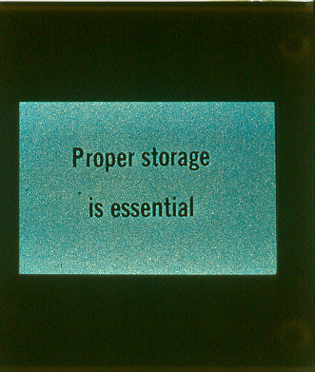
2. Hazardous Chemical Storage

Slide 3
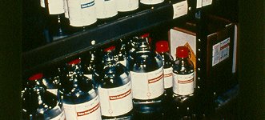
Neat and Orderly is not always safe
Large amounts, cardboard packaging, incompatible material, and improper storage containment compound the dangers.

Slide 4
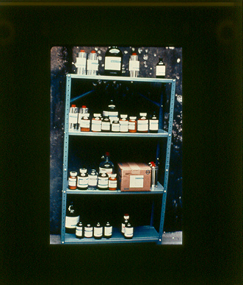
Corrosive and oxidizing materials should not be stored with solvents.
On the bottom shelf is a bottle of Nitric Acid (oxidizer – Yellow color) and Aniline (toxic flammable – Red Stripe)

Slide 5
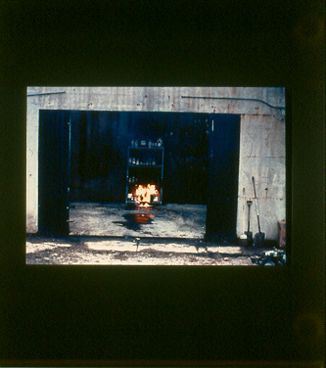
Oxidizers and Flammables can produce a fire without a source of ignition, called a hypergolic reaction

Slide 6
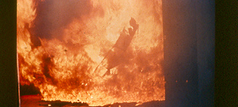
Heat from this or even smaller fires can collapse metal shelving, resulting in more containers breaking.
Shelving should be heavy gauge metal or wood and securely bolted to a wall

Slide 7
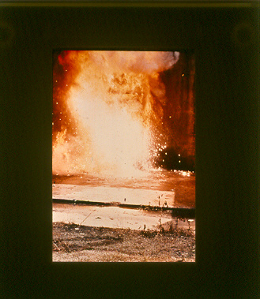
Here a magnesium container breaks open and contributes to the fire. Metal fires are class D fires which most facilities and many fire responders are not equipped to handle

Slide 8
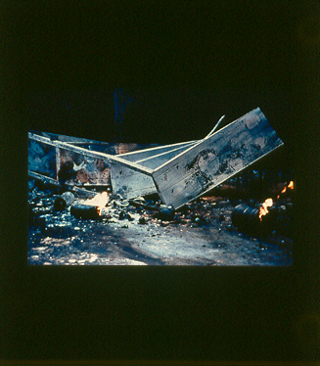

Slide 9
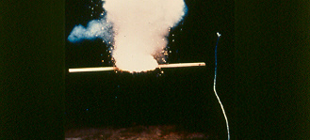
Some materials like Sodium and Potassium will react violently with water to produce a fire or explosion
Only a quarter pound of sodium was needed to produce this reaction in a drum of water.

Slide 10
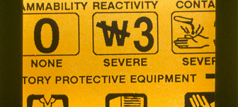
Water reactives should be stored in dry cool areas with no water service.
An excellent source of ignition, they should be stored away from flammables

Slide 11
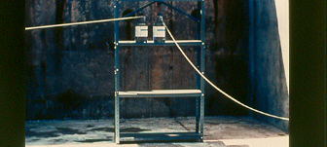
Incompatibles cause problems even without fires
A simple acid-base reaction can cause problems for an entire area. In this case Ammonium hydroxide and hydrochloric acid are combined

Slide 12
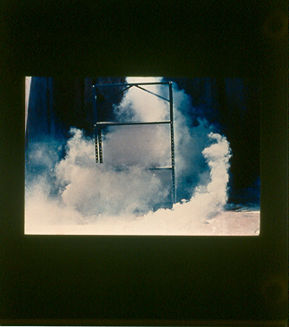
An Ammonium Chloride cloud forms. Not only is it toxic by inhalation but the cloud can cause a “white-out”

Slide 13
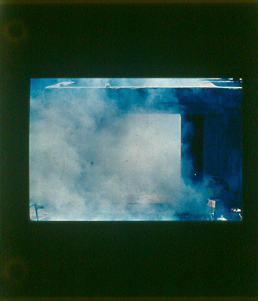

Slide 14
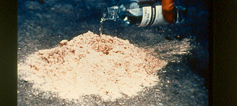
Hazardous chemicals can also react with non hazardous materials, and can be self igniting
Strong Oxidizers like Perchloric acid will react with organic material like sawdust or paper towels.

Slide 15
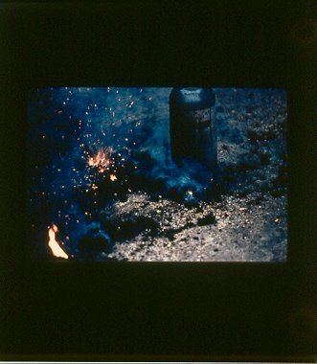
In this case cellulose perchlorate, a shock sensitive, detonatable material. In many cases such as these the fire residues are as hazardous as the original materials.

Slide 16
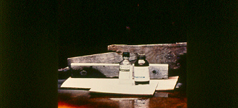
Oxidizers (yellow) react violently with Reducing Agents(yellow striped)
Example – Perchloric acid and magnesium powder

Slide 17
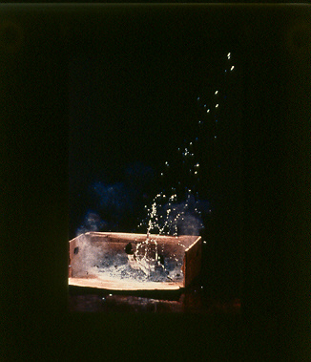
1/6 of a second

Slide 18
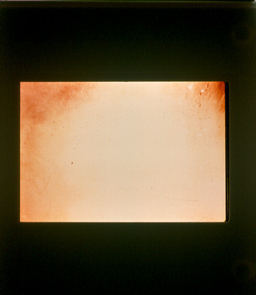

Slide 19
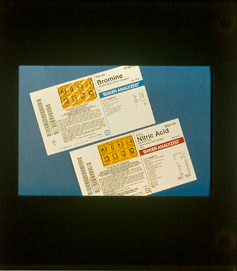
Store Oxidizers and Reducers separately!

Slide 20
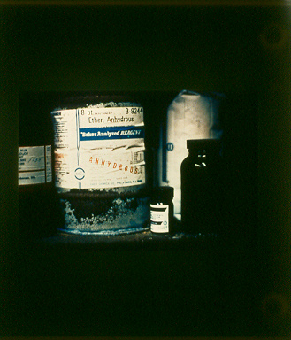
Some Chemicals become more hazardous with age. Example- Ether can pick up oxygen from the air to form explosive organic peroxides. Stabilizers get used up and these materials have expiration dates on the label.
Log in expiration dates
Store no more dated materials than can be used before their expiration date.
Properly stored, opened cans of ether should be kept no longer than six months.

Slide 21
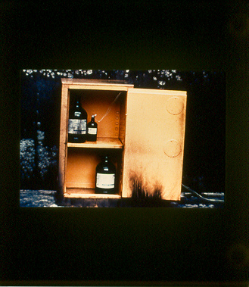
Solvent Storage Cabinet Design
Here one pint of Nitromethane, a highly reactive flammable (Red Stripe) is stored with other Flammables (Red).
If it becomes contaminated or is handled improperly..

Slide 22

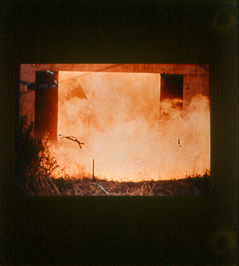
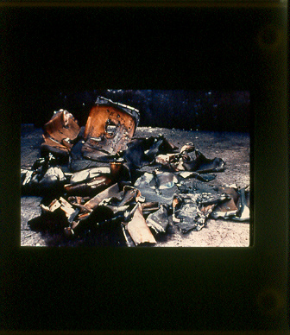

Slide 23

Solvent Storage Cabinets should always be vented, preferably outside.

Slide 24
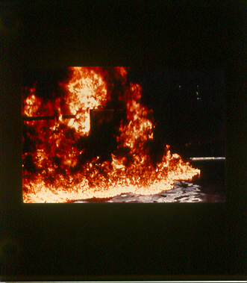
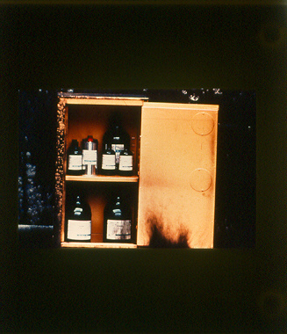

Slide 25
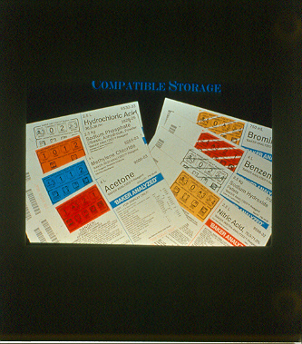

Slide 26
Proper Storage Principles
Hazard Identification
Separation of Materials by Hazard Class
Store minimum quantities
Maintain a current, dated inventory (provide copies for your health and fire departments)
Use Safety Packaging where possible
Provide Proper Protective Equipment and Spill Response Materials
Provide Employee Training

Slide 27


Slide 28
2. Hazardous Chemical Storage- Quiz Questions
3. Chemicals should be stored : (circle one)
a. Alphabetically
b. By hazard class
c. By container size

